Slide 1
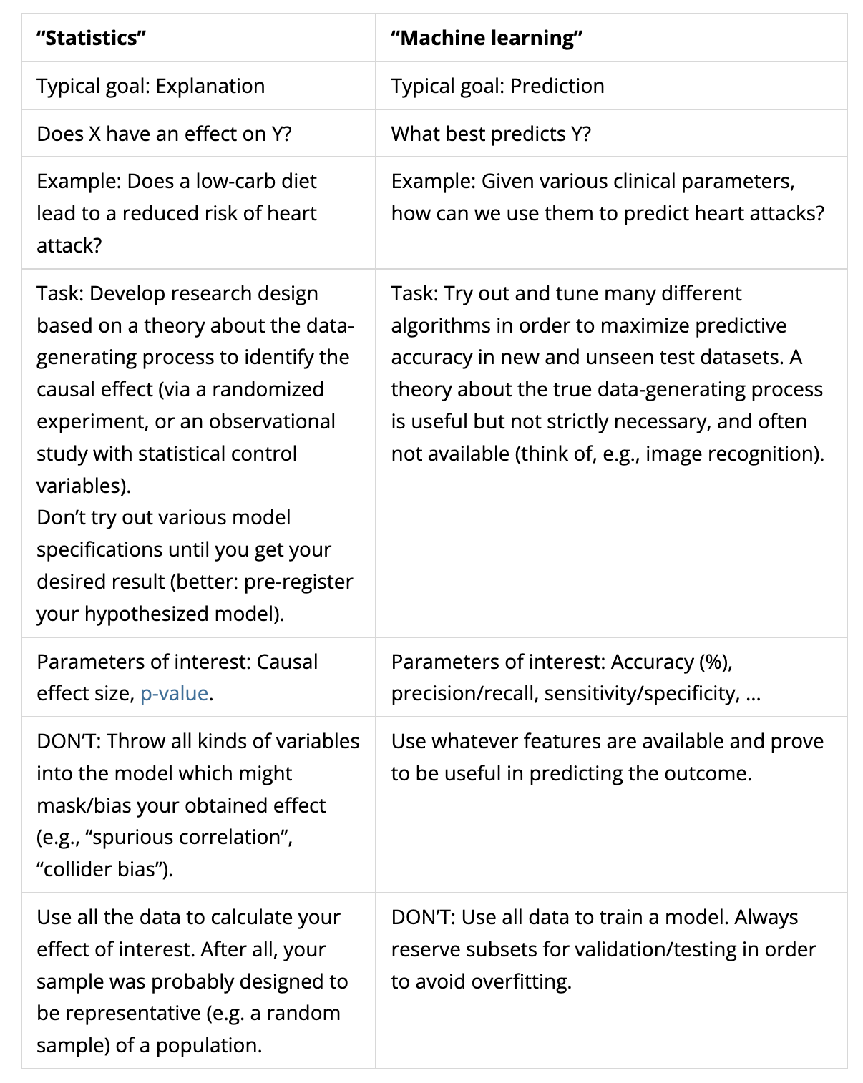

Slide 2

Be My Guest

Slide 3
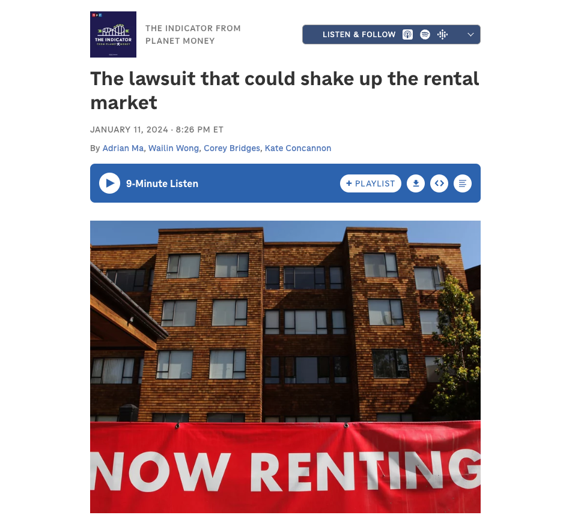

RealPage Controversy
https://www.propublica.org/article/yieldstar-rent-increase-realpage-rent
https://www.npr.org/2024/01/11/1197961038/the-indicator-from-planet-money-realpage-antitrust-lawsuit-01-11-2024
https://www.cnbc.com/video/2024/02/03/how-realpage-influences-rent-prices-across-the-us.html

Slide 4

I am reading this book. You should too!

Slide 5
Geospatial Machine Learning
Part 2.

Slide 6
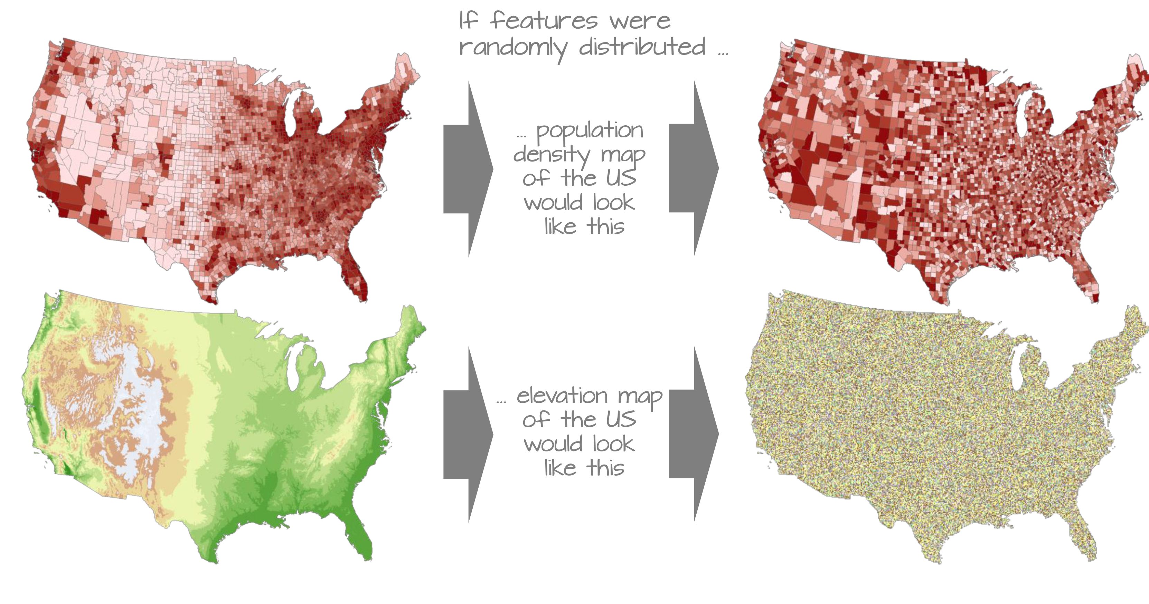
Measures of Spatial Autocorrelation
“The first law of geography: Everything is related to everything else, but near things are more related than distant things.” Waldo R. Tobler (Tobler 1970)
https://mgimond.github.io/Spatial/spatial-autocorrelation.html

Slide 7
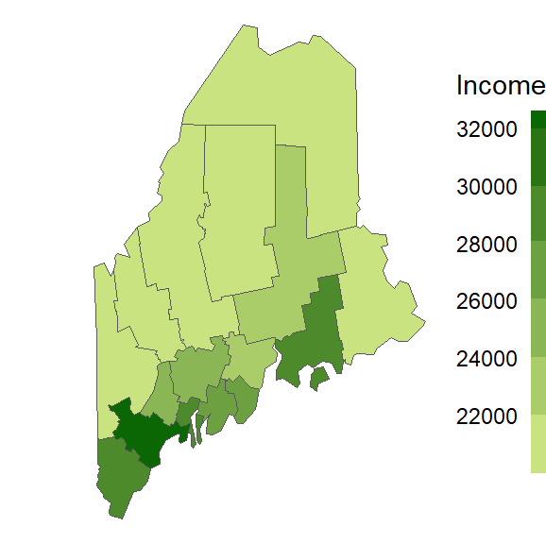
How do we quantify this spatial clustering?
Moran’s I
Correlation coefficient for the relationship between a variable and its neighboring values.
https://mgimond.github.io/Spatial/spatial-autocorrelation.html

Slide 8
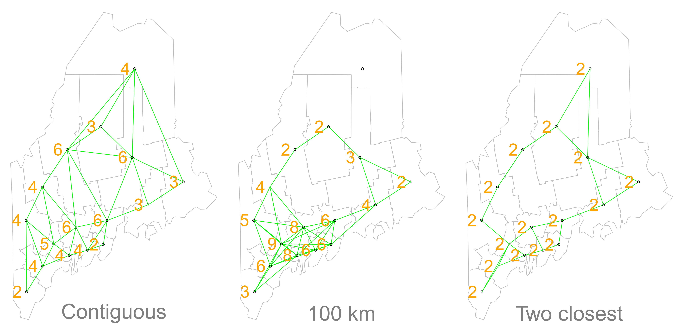
How do we define ‘neighboring’?

Slide 9
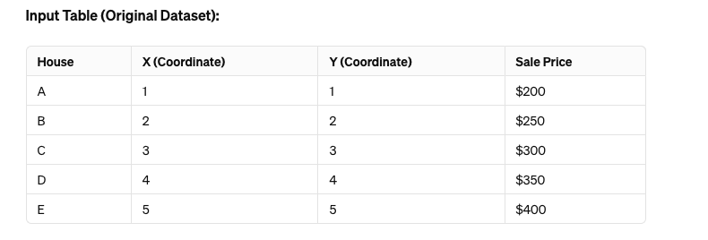
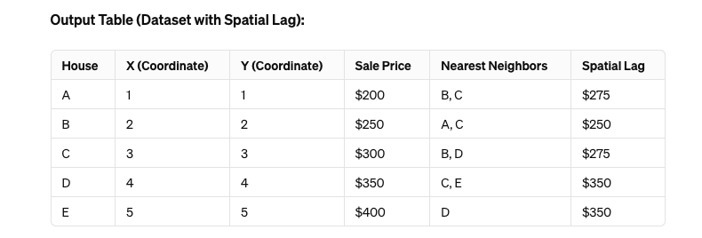
Calculate the ‘Spatial Lag’
The average values of all the neighbors (k = 2NN)

Slide 10
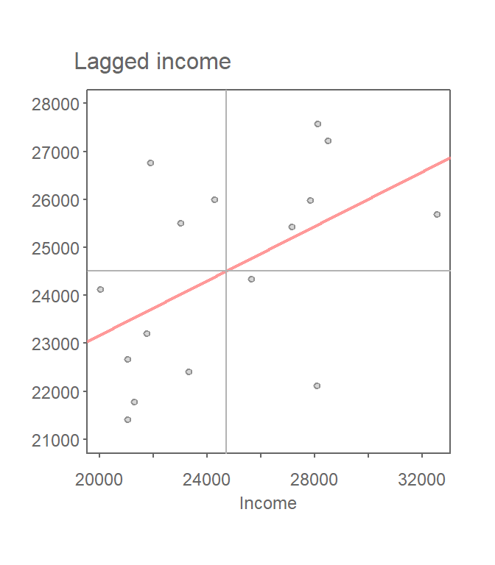
Plot Lagged Value vs. Original Value
Slope of the line is the Moran’s I statistic (after normalizing the spread of values)
If NO association between Income and Income_Lag slope = 0.
Slope ranges from -1 (perfect negative autocorrelation) to 1 (perfect positive).
Here, is it a value of 0.28. Is that significant??

Slide 11
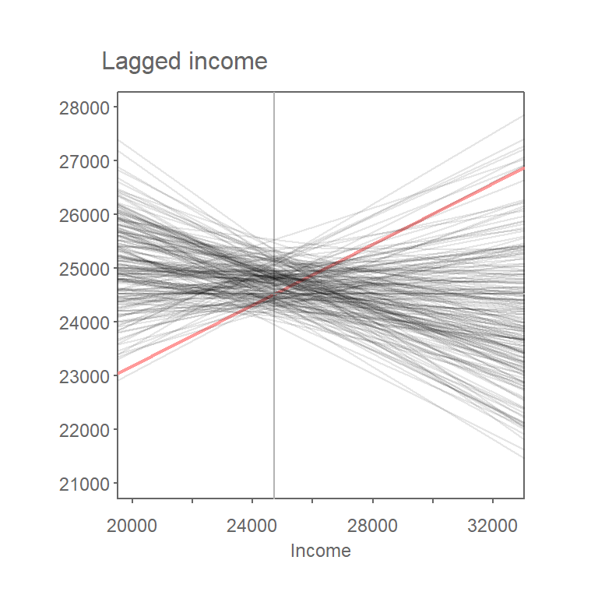
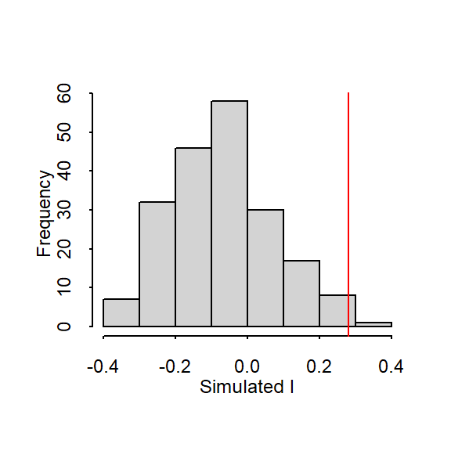
Monte Carlo Approach to Estimating Significance
The observed value of 0.28 is
not very common if we were to randomly distribute values across each county.

Slide 12
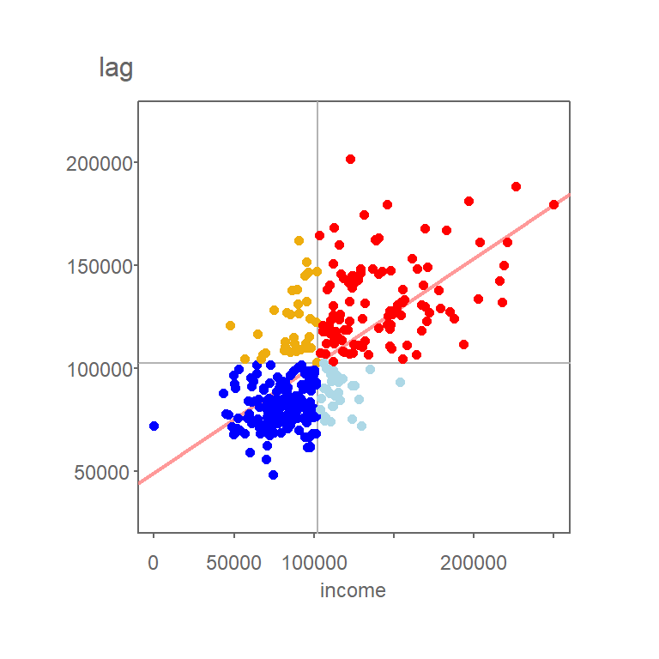
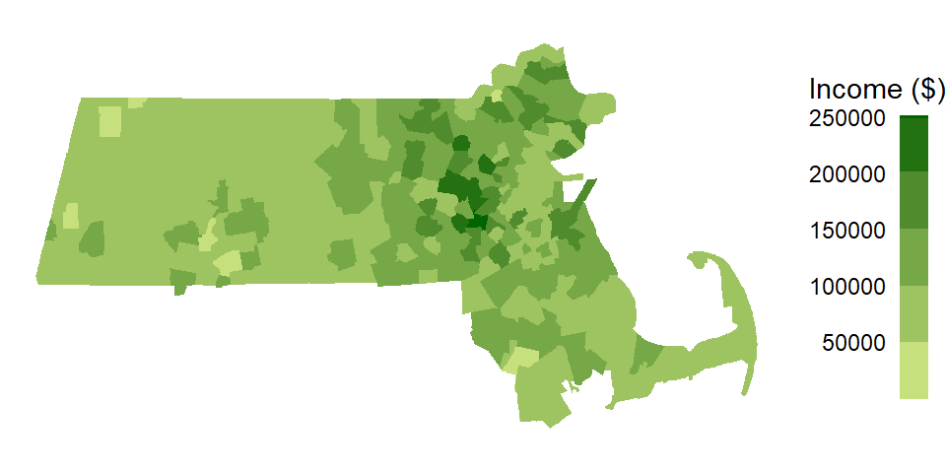
Local Moran’s I
Decompose global Moran’s I (single value) to a local value for each observation.
Create a map of ‘hot spots’ and ‘cold spots’
Values above the mean located near other values above the mean or vice verse.

Slide 13
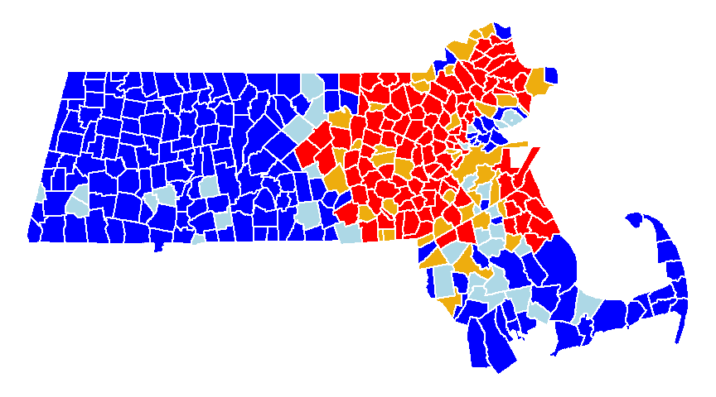

Slide 14
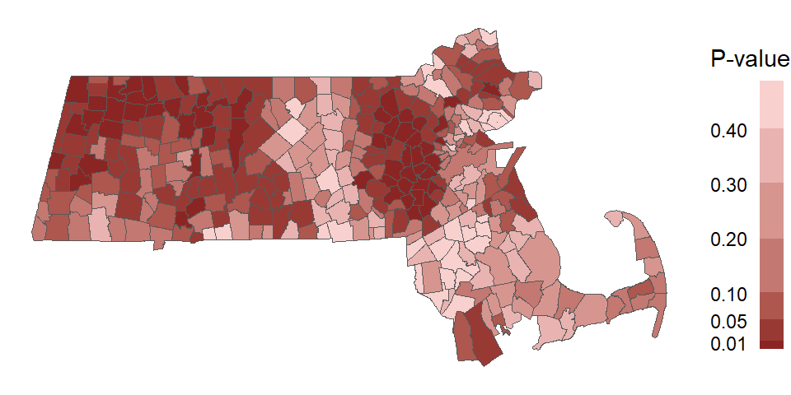
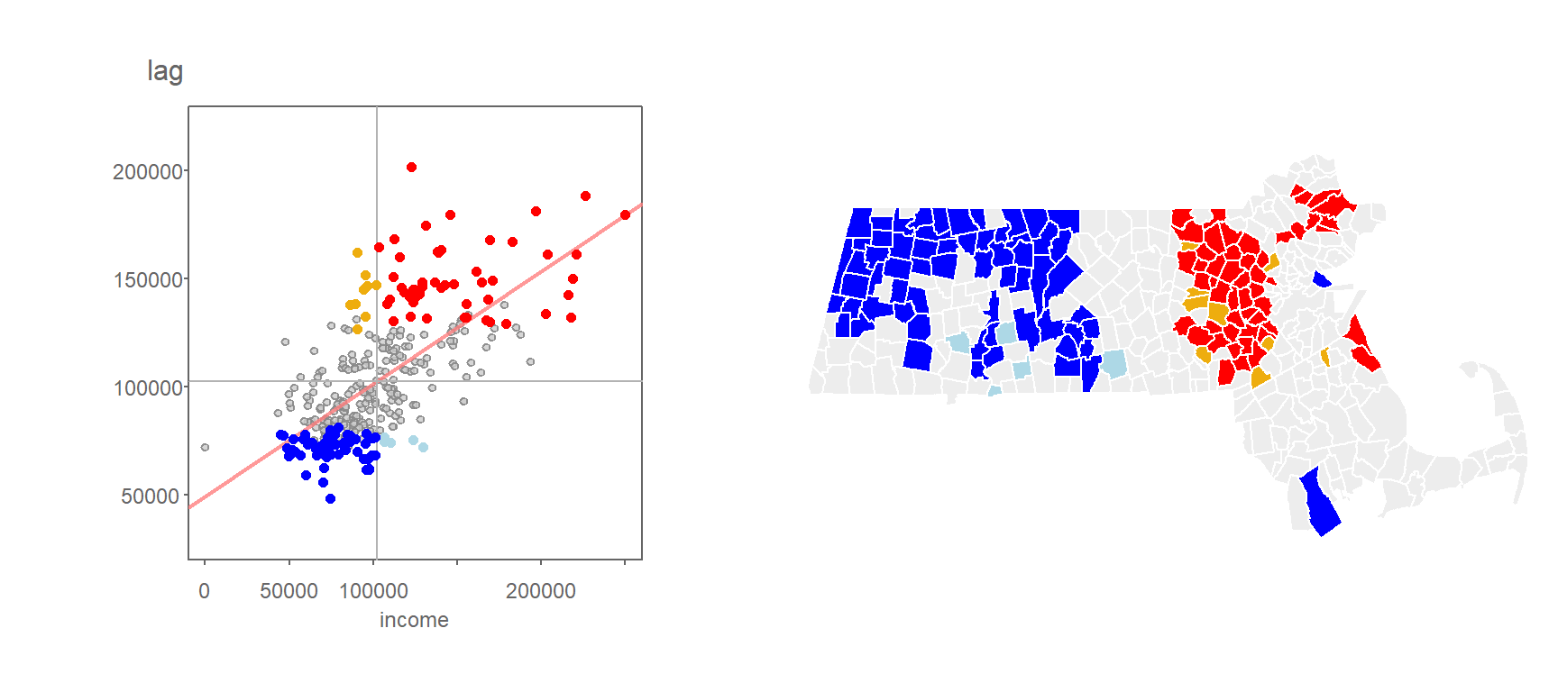
Adding in Significance

Slide 15
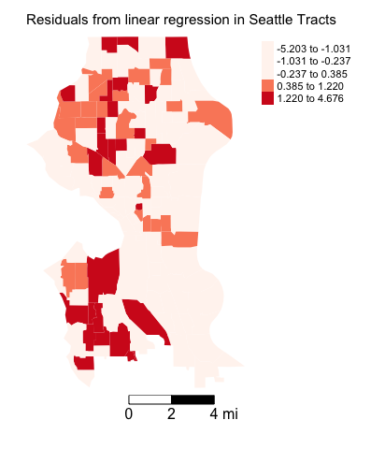
Clustering of Residuals
Are there errors spatially clustered?
Is there an obvious pattern?
Gives us clues about potential misspecification.
https://crd230.github.io/lab8.html

